Slide 1
AdaBoost Regression
Mohamed Faiz
19/07/2024

Slide 2
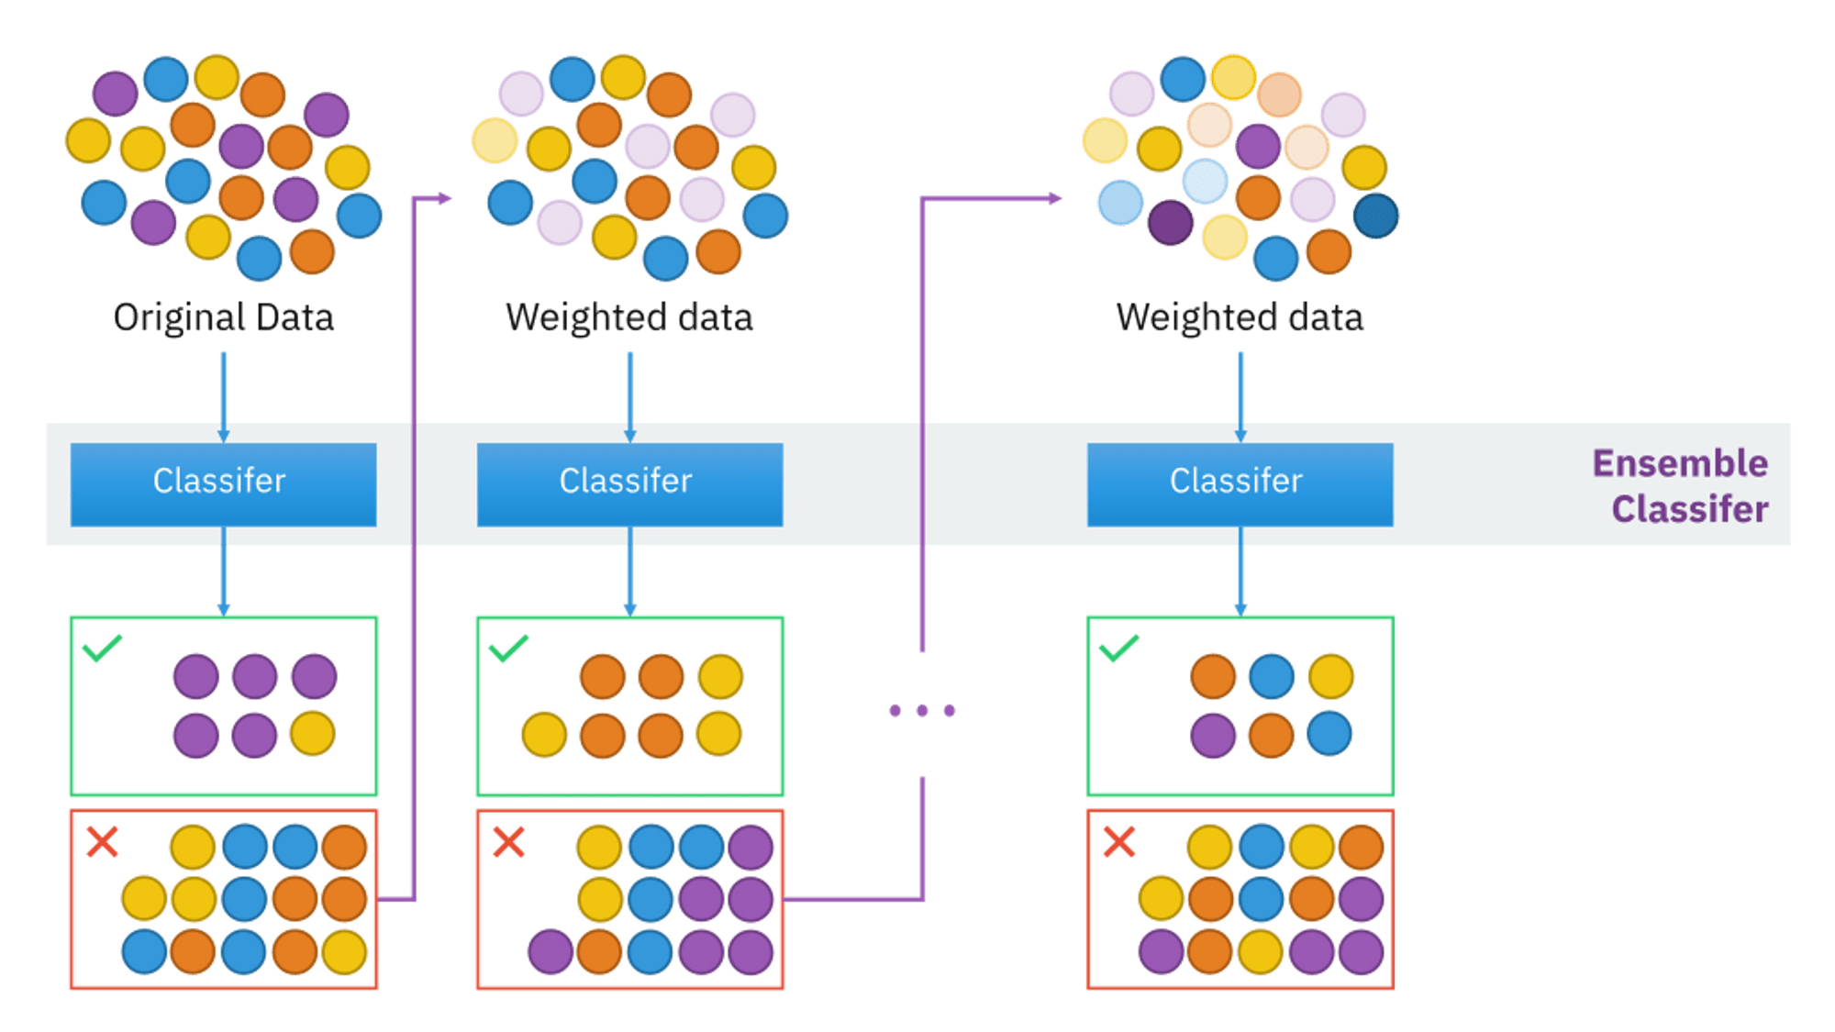
AdaBoost Regression

Slide 3
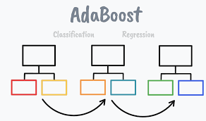
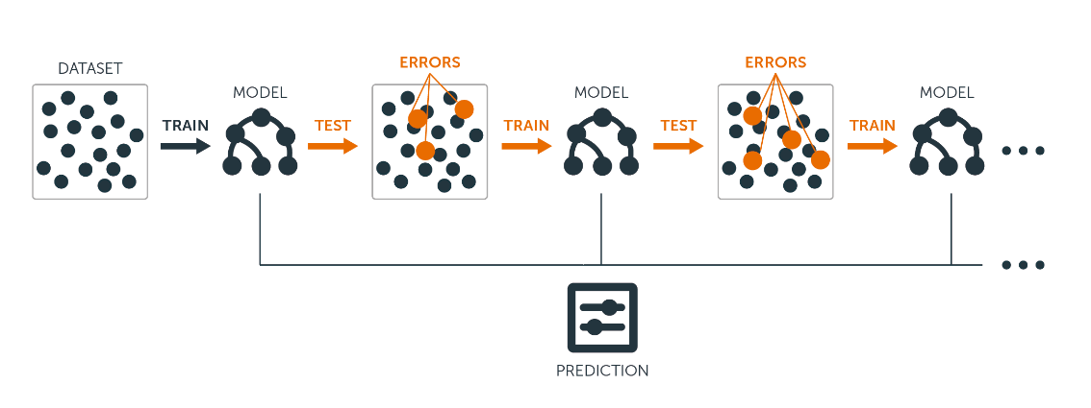

Slide 4
Introduction to AdaBoost:
AdaBoost stands for Adaptive Boosting.
It is a type of ensemble learning technique used to improve the performance of machine learning models.

Slide 5
Principle of AdaBoost Regression:
Combines multiple weak learners to form a strong learner.
Iteratively adjusts the weights of training instances based on the error of the previous model.

Slide 6
Advantages:
Improved Accuracy:
Boosts the performance of weak learners.
Adaptability:
Adjusts to errors and focuses on difficult-to-predict instances.
Flexibility:
Can be used with various base learners

Slide 7
Disadvantages:
Sensitive to Noisy Data:
Performance can degrade with outliers.
Computational Cost:
More computationally intensive than single models due to iterative nature.
Overfitting:
Can overfit if not carefully managed, especially with complex models.

Slide 8
Thank You
Mohamed Faiz
19/07/2024

